Slide 1
Tableau Hands-On Nabil Beitinjaneh

Slide 2
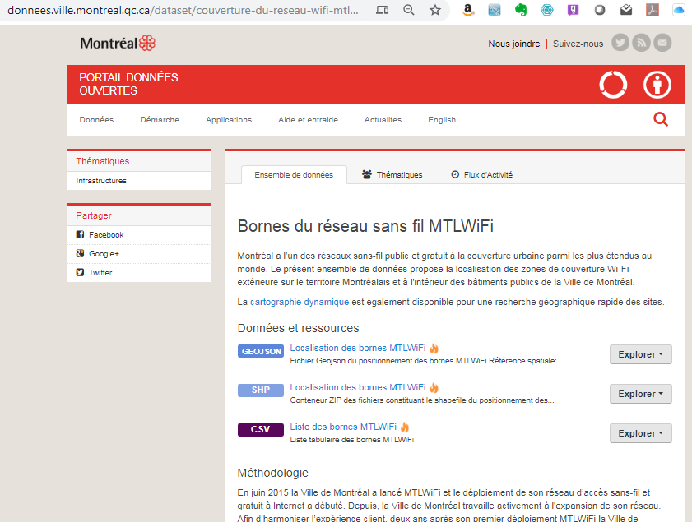
WIFI coverage in Montreal
http://donnees.ville.montreal.qc.ca/dataset/couverture-du-reseau-wifi-mtlwifi

Slide 3
WIFI coverage in Montreal –p2
Connect to the mtlwifi_bornes file
Once the data is loaded follow these step:
Note - the fields used here are the actual Latitude and Longitude fields that are in the data set, not the “Generated” latitude and longitude that Tableau generates based on geographic fields.
Move Longitude to Columns.
Move Latitude to Rows.
Move ID to Details on the Marks card.
Move Type to Color on the Marks card.
Adjusting size, color and map layer:
Select Size on the Marks card and adjust the size to make the circles smaller.
Select Color on the Marks card and then Edit Color (or double click a color on the color legend).
Group as you see appropriate
Create a Dashboard with filters.

Slide 4
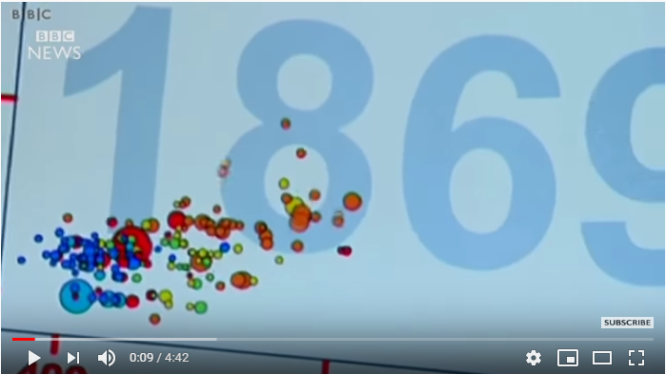
Reproducing Hans’ presentation
https://www.youtube.com/watch?v=Z8t4k0Q8e8Y

Slide 5
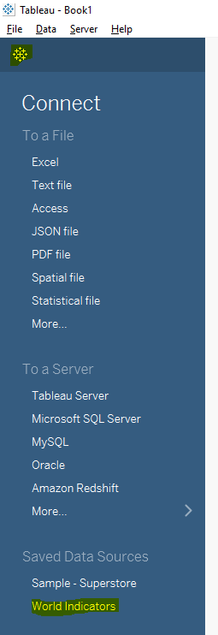
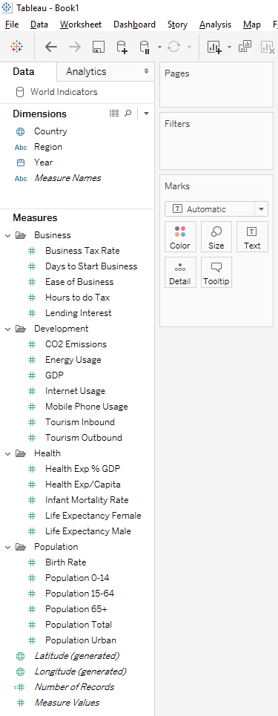
Reproducing Hans’ presentation p1
If not – go to the McGill OneDrive

Slide 6
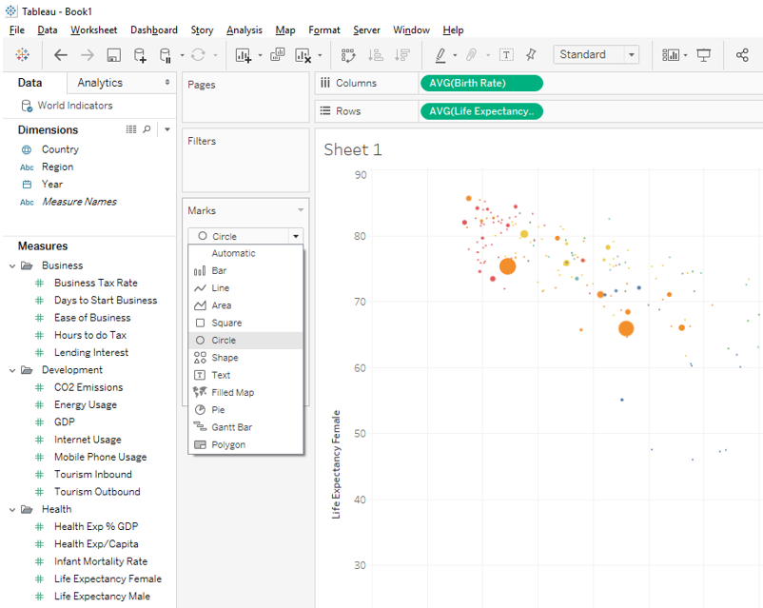
Reproducing Hans’ presentation –p2
Once the data is loaded follow these step:
Move Life Expectancy Female to Rows and Birth Rate to Columns.
Move Country to Details on the Marks card.
Move Region to Color on the Marks card.
Move Population Total to Size on the Marks card.
Using the dropdown box on the Marks card, select Circles.

Slide 7
Reproducing Hans’ presentation –p3
Adjusting size and color:
Select Size on the Marks card and adjust the size to make the circles larger.
Select Color on the Marks card and set Opacity to 65%.
Select Border and pick a medium gray color.
Note - the opacity and border is a useful tool when lots of dots plot on top of each other.
Creating Animation:
Move Year to Pages.
The visualization is now interactive. The play control will show up on the right-hand side of the Tableau canvas. The user can select year by year or hit the play control with the speed set to slow, medium or fast.

Slide 8
Reproducing Hans’ presentation –p4
Now redo exercise with the Gapfinder Consolidated file (larger)

